Slide 1
Facing violence
From counter-protestors
From the alt-right
From the left

Slide 2
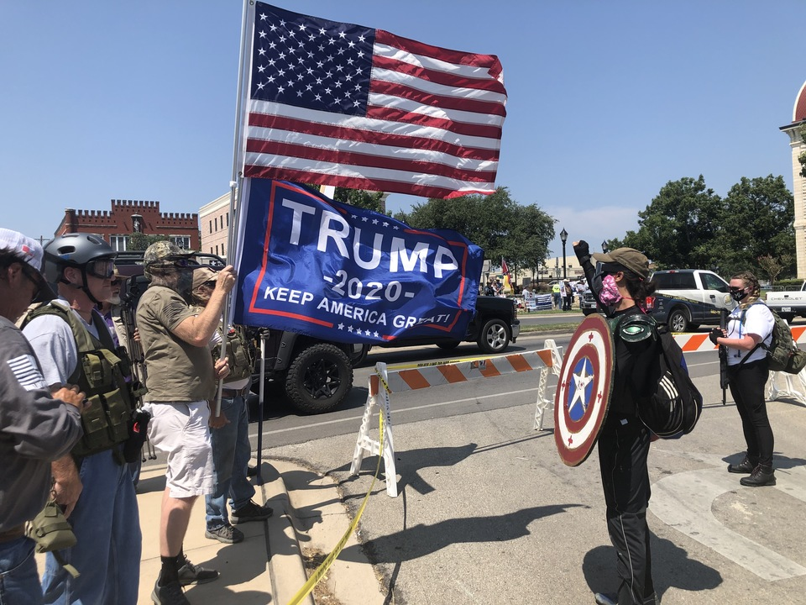
Counter-protesters
Notes:
Best to deal with them by ignoring them.
Try to route the action away from them.

Slide 3
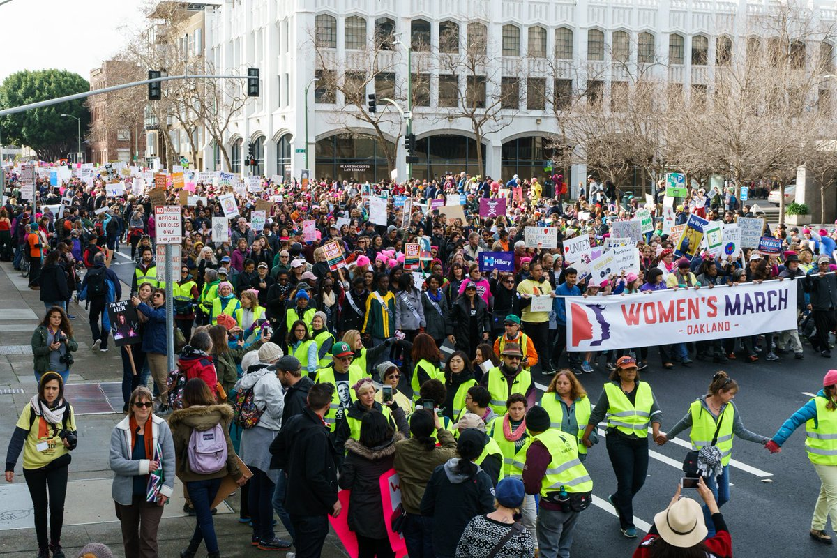
Form lines of Peace Ambassadors
Notes:
Form a line of Peace Ambassadors
Stop rear of march, keep front moving forward
Leave a substantial space between to make it clear to media and law enforcement that they are not part of the action.

Slide 4
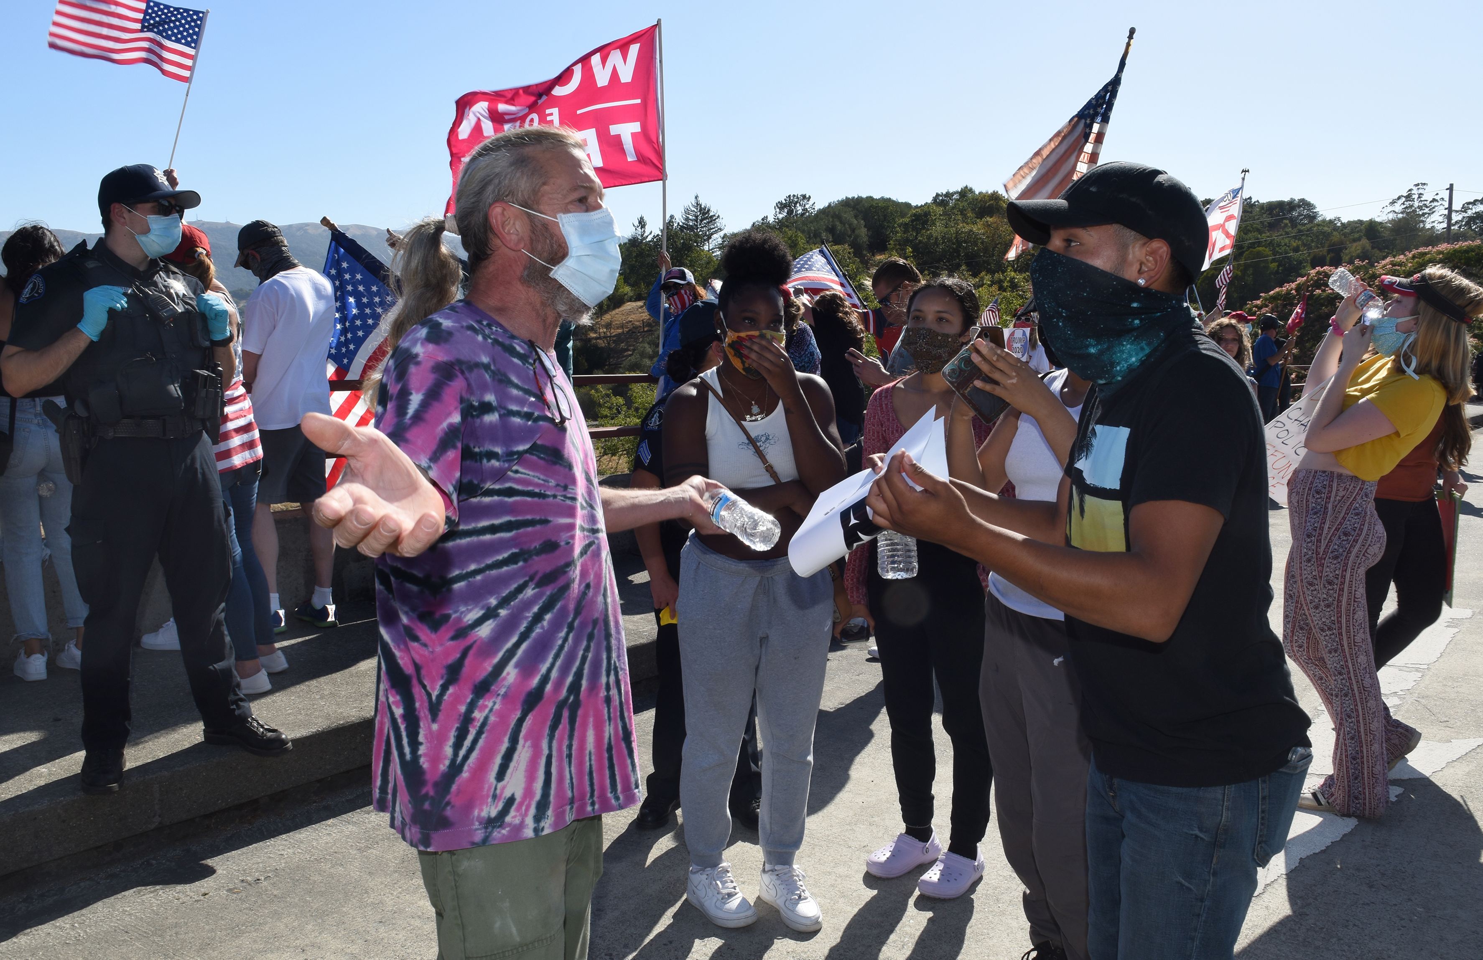
Divert attention away from counter-protesters
Notes:
Our attention shouldn’t be on them, but on keeping OUR people safe.
In case of violence: isolate, separate, call in help through chain of command.
The underlying message is that we are there to keep our protests nonviolent and peaceful.
Counter-protesters will come. Try to divert the attention of our marchers.

Slide 5
Who embraces violence at rallies?

Slide 6
opportunistic looters
those goading law enforcement to violence
right wing organizations and philosophies
left wing organizations and philosophies
Groups & Philosophies
Notes:
We are told that the marches, protests, and demonstrations this year have been violent. In fact, violence has occurred very infrequently. When it does occur, it gets media attention.
What violence there has been have come from several sources:
Opportunistic looters – some of them have legitimate anger, some just take advantage of the chaos, others are inciting violence
There have been a good number of confrontations between police and demonstrators that has led to violence from both sides
There are right wing organizations who have incited violence, and some people on the left whose philosophy leads them to respond with violence

Slide 7
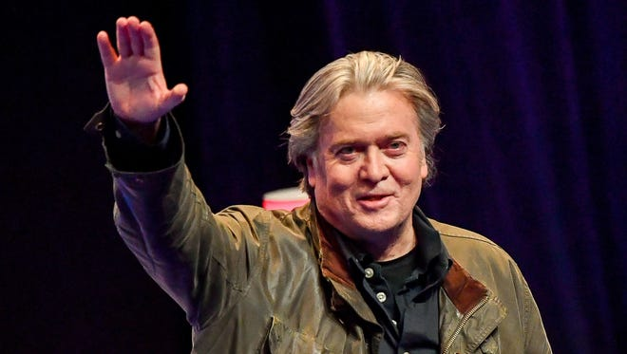
Alt-Right
Stephen Bannon
Milo Yiannopoulos
Jared Taylor
David Horowitz
Matthew Heimbach
Notes:
The term “Alt-Right” originated in 2008 to describe a form of white nationalism. It encompasses a good number of organizations/ people who support a white supremacist agenda.
They have a sizable number of spokespersons. From Stephen Bannon, leader of Breitbart News and one of President Trump’s campaign team, to and including such notables as Milo Yiannopoulos, Jared Taylor, David Horowitz, Matthew Heimbach. Among their many hate organizations are what are called fight clubs, such as Proud Boys or the Fraternal Order of Alt- Knights.

Slide 8
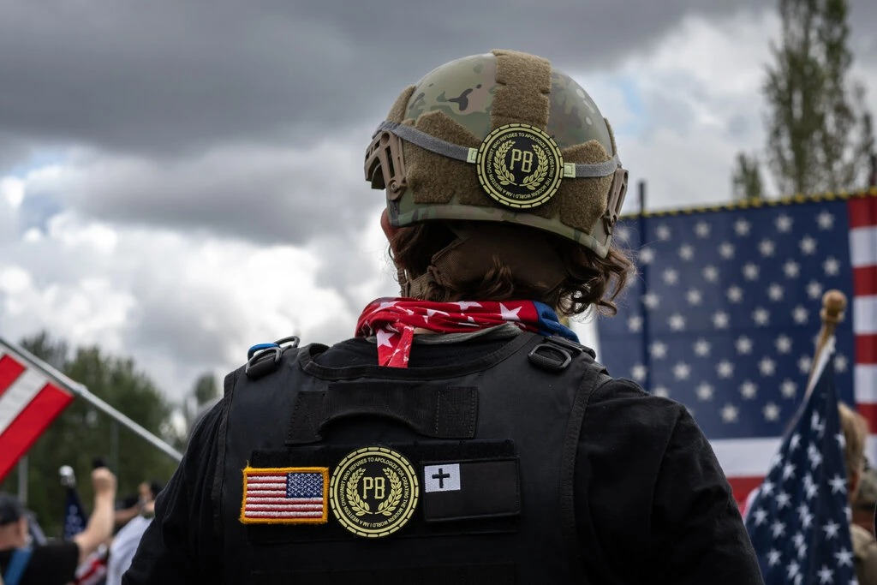
Proud Boys
Notes:
Among their many hate organizations are what are called fight clubs, such as Proud Boys or the Fraternal Order of Alt- Knights.
Their goal at their rallies or when they disrupt peaceful rallies is to provoke confrontation and violence, and leading the media to believe that they are the victims whose free-speech rights are being denied. The two fight clubs I mentioned include in their initiation street fighting and specifically brawling with anti-fascists at public rallies.

Slide 9
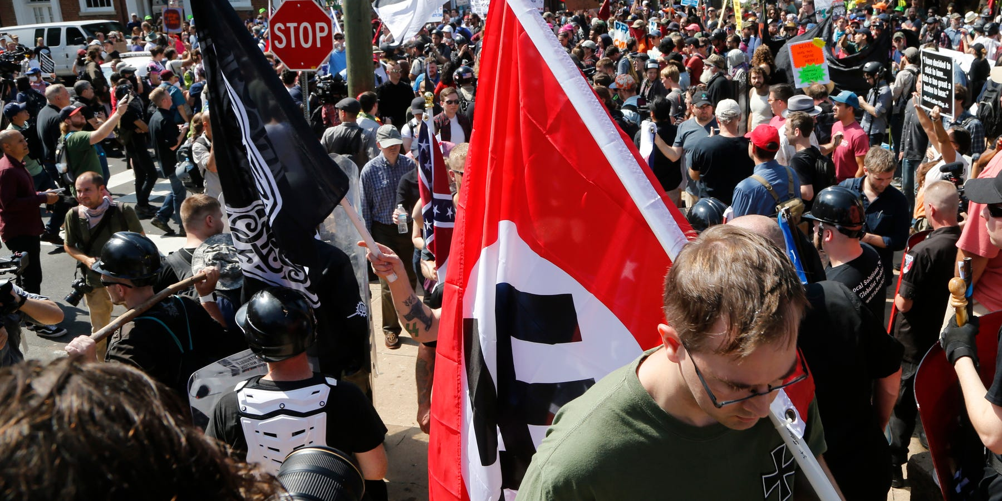
Neo-Nazis
Notes:
Neo-Nazis: coming from people and groups that want to revive the ideology of Nazism, e.g. ultranationalism, racism, xenophobia, homophobia, antisemitism, anti-communism, denial of the holocaust

Slide 10
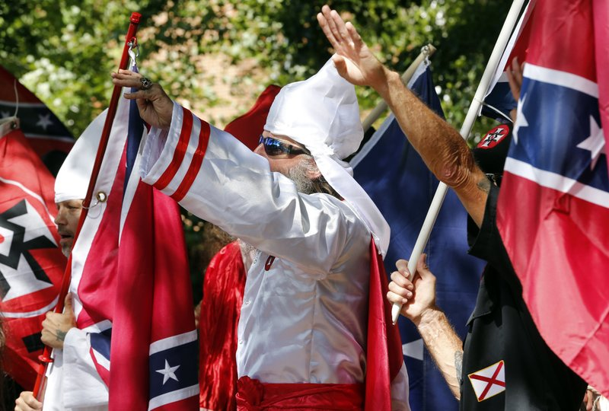
KKK
Notes:
KKK: coming from the Civil War with deep resentments about African American or Jewish people

Slide 11
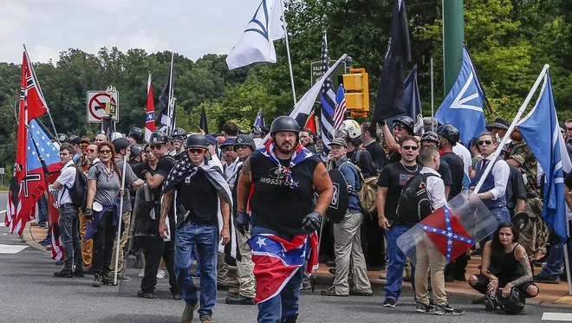
Other White Supremacists
Notes:
Other white supremacists
Proud boys
Fraternal Order of Alt-Knights
More than 30 others in U.S.

Slide 12
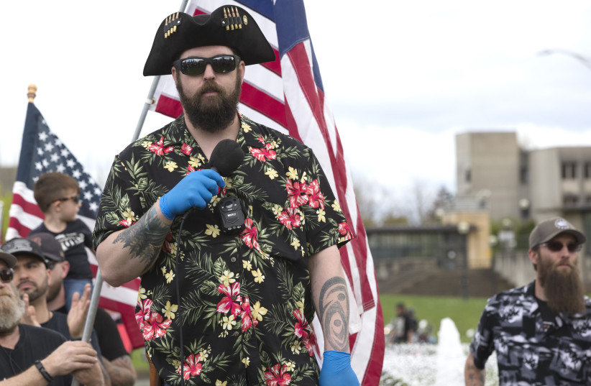
Boogaloo Bois
Notes:
Boogaloo Bois Often wear Hawaiian shirts and military fatigues
Many white supremacist and neo-nazi
Believe the “boogaloo” will be a race war, or the next civil war
Targets most likely police or people in authority
Roots traced to the Oklahoma City bombing and Waco and Ruby Ridge
Recently implicated in the killing of an USAF guard and a Santa Cruz deputy
Were involved in the attempted kidnapping of Michigan Governor Whitmer
Groups in the boogaloo movement are far-right, anti-government, and pro-gun. Supporters see the current federal government as illegitimate, while remaining deeply patriotic. They revere the constitution and see themselves as the true descendants of America's founding fathers. In their view, current US lawmakers are the equivalent of occupying British forces during the revolutionary war.
These are dangerous people. They will come to a protest heavily armed. They typically don’t target protesters, but their goal is a civil war.

Slide 13
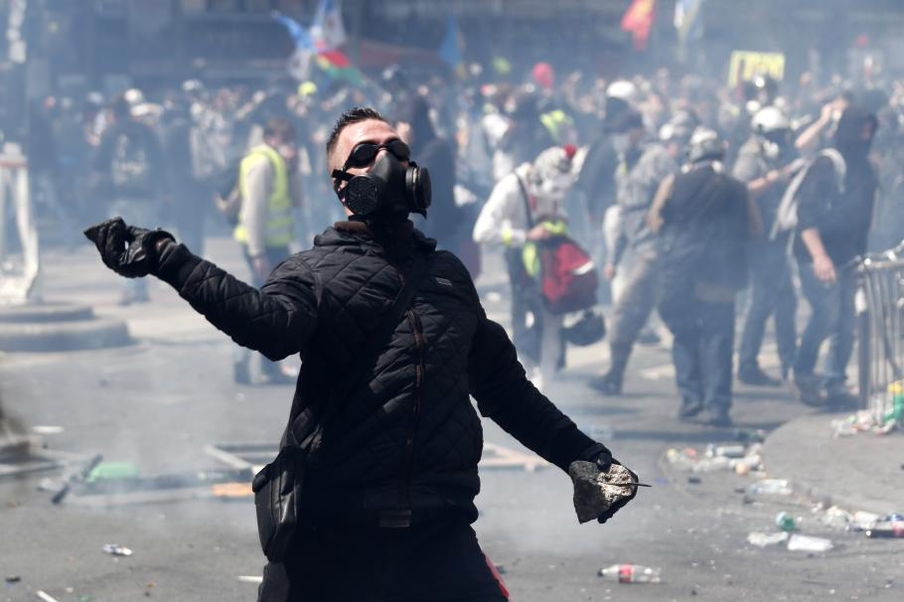
On the left
Antifa
Black Bloc
Notes:
From the left are two known groups who believe in violent confrontation to silence the ALT-Right.

Slide 14
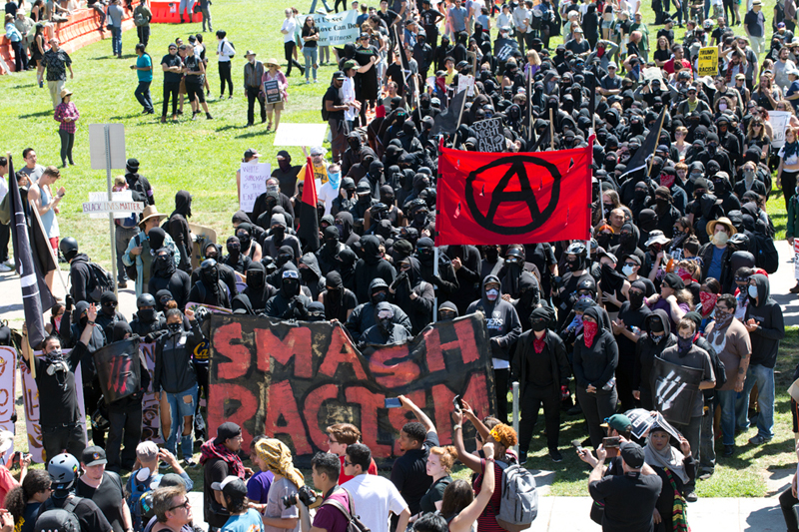
Antifa (anti-fascist)
Notes:
Antifa is a philosophical belief that violence is justified in silencing the ALT-Right.
Contrary to what the Trump administration has said, they are not an organization.
And there have only been a handful of incidents where they were involved in violent attacks on police or the people on the right.
Those who adopt the Antifa philosophy may have other beliefs that lead them to engage in violent behavior. But that is independent of their belief in the Antifa philosophy.
meaning anti-fascist
arose in the 1980’s in Europe to fight neo-Nazism
they argue that Naziism, and by extension the ALT-Right, should be silenced and that they need to be willing to physically make that happen
a philosophy, not an organization
a very few of them have been implicated in violence
the Trump administration has gone out of its way to mischaracterize them as organized terrorists

Slide 15
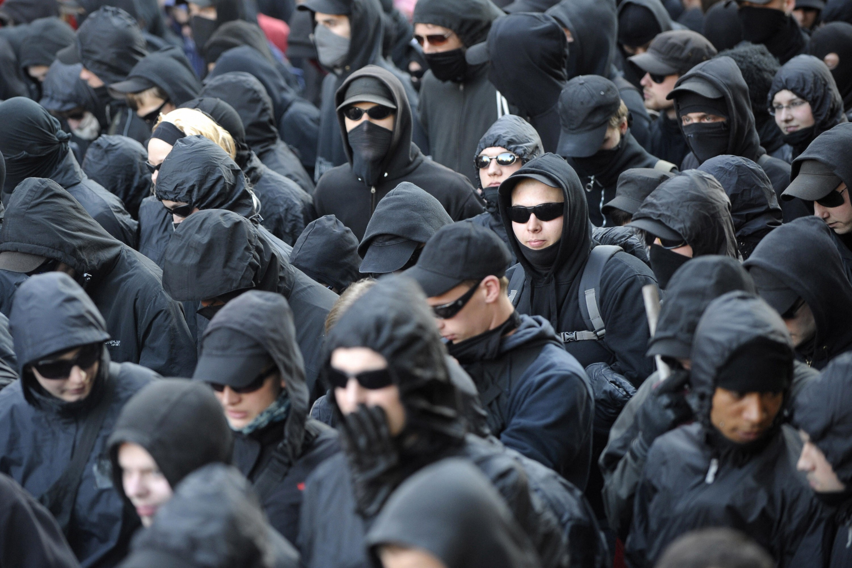
Black Bloc
Notes:
Black Bloc is similar. They are not an organization. They are usually ad-hoc groups who have adopted the black block tactic to confront the white supremacists.
origins in Germany in the 1980’s to fight nuclear power and neo- Nazis.
Engage in “symbolic” violence (desecration of symbols of capitalism or defending protesters)
A tactic, not an organization

Slide 16
The cost of Antifa and Black Bloc is well known
1928 – Wedding district of Berlin
Nazi rally
Communist response
Violent confrontations
Nazis characterize communists as violent
Gain support with promise to protect
2017 - Charlottesville & Berkeley
White supremacists
Antifa
Violent confrontations
Trump defends white supremacists
Calls antifa violent
Promises to protect
2020 – Portland
Police and federal thugs
Antifa
Violent confrontations
Trump calls antifa violent
Promises to protect America
Notes:
It goes back to Germany when Hitler and Naziism were on the rise. In the Wedding neighborhood of Berlin where many communists lived, Nazis showed up to hold a rally. That led to violence against each other. But Hitler used that to characterize the left as violent. Many Germans became so afraid of that that they embraced the Nazis. It became a major recruiting tool of Hitler.
Here in this country, at Charlottesville and Berkeley especially, the violence of Black Bloc and Antifa changed the narrative in the press to one where the left became the agitators of violence, denying freedom of speech to the haters. It even allowed President Trump to talk about the bad hombres on both sides at Charlottesville!
And in the BLM protests, especially in Portland, Oregon, we saw demonstrators being targeted by secret troops sent in by the Trump administration, who fed and incited violence. Confrontation from the demonstrators, particularly Antifa, led to Trump trying to label antifa a terrorist group. Trump rallied his supporters by saying he would protect them from Antifa!

Slide 17
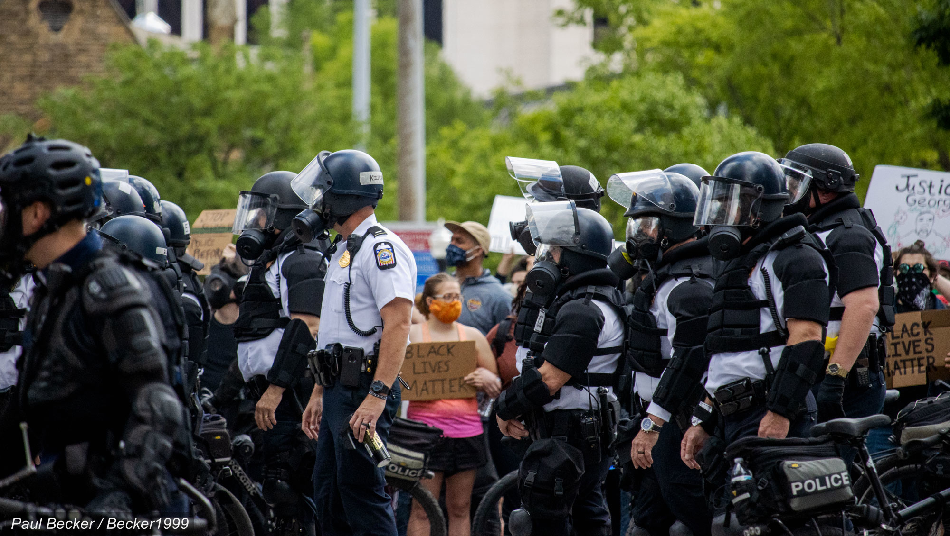
Law Enforcement
Notes:
As we learned so painfully this year, law enforcement can be the source of violence at demonstrations. It can happen for two reasons:
Officers who hate the demonstrators
Officers doing their job, as taught to and authorized for them
Steps have been taken to avoid the violence shown by police in many of the BLM protests. But we need to be prepared should it occur.
“Bad cops”
Good cops, using the tools given to them
May have guns, tear gas, pepper spray, concussion grenades, rubber bullets
May be responding to others who are using violence

Slide 18
Who is inciting the violence
?
Notes:
If you encounter anyone or group who is inciting violence, most likely you will not know who they are or why there are doing it.
Other than the police, you will only know what you see, that someone is looting, attacking the police or other demonstrators, or doing something else to incite violence.
Depending on the circumstances, the one thing you can do to help is to record what is happening.
If it is safe to do so, and you do not need to be helping peaceful demonstrators get away from the violence, record it on your smartphone.

Slide 19
How do we respond to violent provocation?

Slide 20
They seek confrontation
They want to be portrayed as victims, the whole point of white supremacy
They will use violence from our marches to convince the media and viewers that we (progressive marchers) are the violent ones who are trying to silence them
Overarching
Moral on Responding
Notes:
Over and over again, to this day in Portland, Minneapolis, Lexington, Kenosha, etc., etc., etc., where violence has occurred, no matter who the instigator, it has allowed the administration to brank all protest as violent and anti-American. It is a tool to win people over with his promise to rid the nation of violent protesters.
[story about Nov 15th moratorium in Washington, DC]
When the authorities counter violence, their weapons will overwhelm any violent protesters. This is their game. They know war. Peaceful protesters can only meet that with that which they don’t understand. Nonviolence.

Slide 21
Observe your surroundings
Be extra vigilant
Encourage crowd to ignore the provocation
Alert safety team
Alert legal observers
Use de-escalation skills
Ignore
de-escalate
Notes:
Be extra vigilant and observe the surroundings.
If you see counter demonstrators approaching with signs or taunts:
Encourage the marchers to ignore them
Alert the Peace Ambassadors around you and let the coordinator know Keep marchers from confronting them
Alert legal observers and police if violence seems imminent
If counter protesters engage in shouting or taunting, or threatening
Use your de-escalation training
Keep peaceful marchers moving, ignoring the provocation
Lead marchers to sing

Slide 22
Work in small teams
Isolate violence
Sit, kneel, sing
Stretch arms and lock hands
Universal defense posture
When
violence
is imminent
Notes:
Work in small teams
Isolate violence → “We’re watching you”, “Can we move back a little?”
Sit down, or kneel, Sing
Stampede → Stretch arms and lock hands
Tear gas → arms in air, slowly walk away, chant “Slowly… Walk… Slowly…”
Universal defense posture → sit down, fold legs in, bend over, and clasp hands behind neck

Slide 23
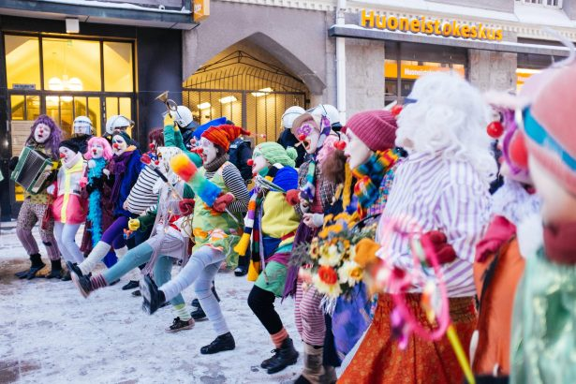
Humor
Story Spotlight:
Nazi rally in Knoxville
Notes:
At a Nazi rally in Knoxville: people dressed as clowns. When the Nazis shouted “white power” the clowns retorted “white flour”, and threw fistfuls of flour in the air, or they retorted “white flowers?” and handed out white flowers, or again when female clowns retorted “oh, wife power!” raising letters in the air to spell it out.

Slide 24
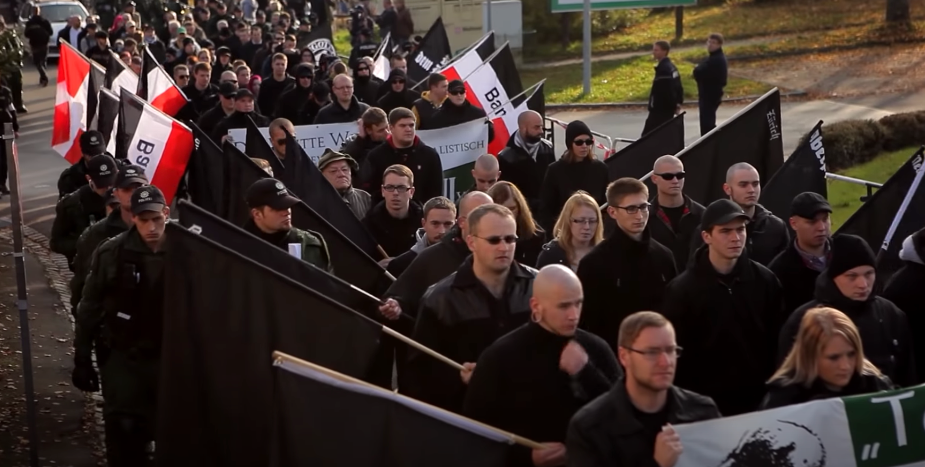
Walkathon for Nazis
Story Spotlight:
In Wunsiedel, Germany
Notes:
In Wunsiedel in Germany: the people turned a Nazi march into a walk-a-thon for an anti- hate group organization. Residents committed to donating money for every meter that the Nazis marched. When the marchers came to town, the residents welcomed them, celebrated, and thanked them for raising money to fight Nazism.
https://www.sbs.com.au/topics/voices/culture/article/2017/08/21/german-town-gives-lesson-how-calmly-oppose-nazi-march
https://www.youtube.com/watch?v=KvjIYl_Nlao&feature=emb_logo

